Slide 1
Collecting IoT Data with Azure

Slide 2
Agenda
Short Introduction of me and our group Wankuma Alliance
Reporting our previous project, collecting IoT data with Azure
Guide of Microsoft’s new device, Azure Sphere.

Slide 3
Introduction

Slide 4
Self Introduction
Name: Tomoya Yamanaka(Japanese)
Place: Ortigas
Facebook: https://www.facebook.com/tomoya.yamanaka.54
Activity: Wankuma Alliance Manila
(IT Seminar Group)
Facebook: https://www.facebook.com/groups/WankumaAlliancePh/

Slide 5
Collecting Iot data with azure

Slide 6
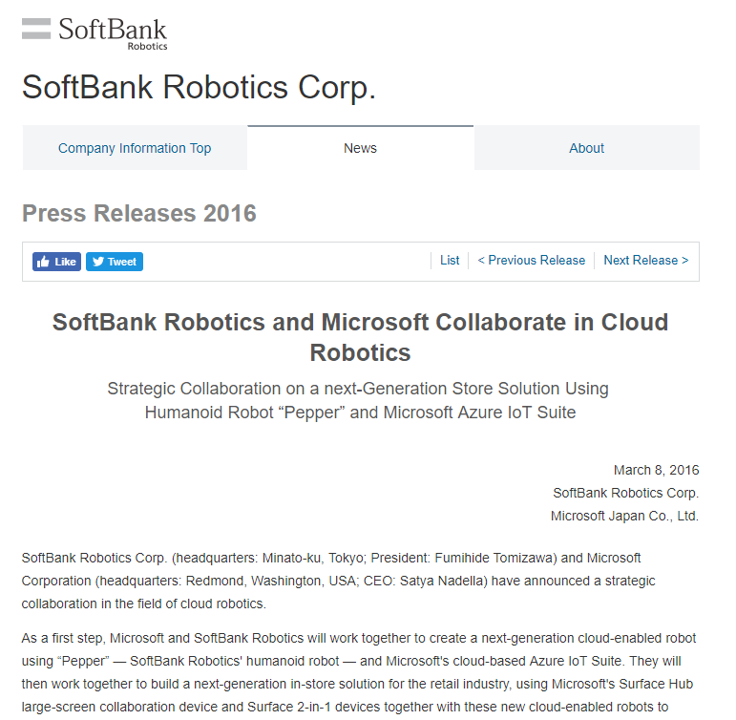
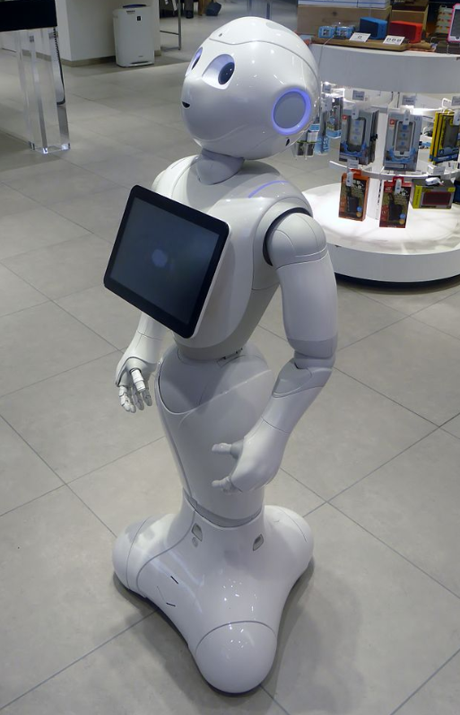
IoT data collecting system with Azure
We have IoT data collecting system experience.
I’d like to share the experience.
https://www.softbank.jp/en/corp/group/sbr/news/press/2016/20160308_01/
https://en.wikipedia.org/wiki/Pepper_(robot)

Slide 7
1st Request
The client wanted to collect data from their product robots.
They expected millions of report data per hour because they wanted to sell quite lots of robots.
The collected reports will be analyzed by different group.
Millions of reports will be generated!!

Slide 8

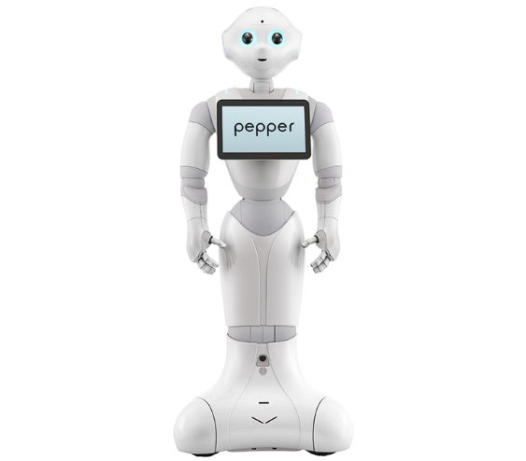
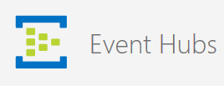
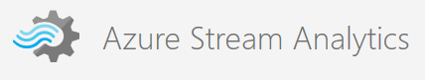
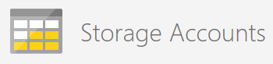
IoT data collecting system 1st version
Super lots of reports
Content of reports:
-When to recognize visitor
-Gender of visitor
-Age of visitor
-# of visitor
and so on

Slide 9
IoT data collecting system 1st version
Event Hubs can process billions of request per day.
Super lots of reports
:Receiving
Content of reports:
-When to recognize visitor
-Gender of visitor
-Age of visitor
-# of visitor
and so on
:Filtering
:Storing

Slide 10
IoT data collecting system 1st version
Super lots of reports
Stream Analytics filter and process the input data
:Receiving
Content of reports:
-When to recognize visitor
-Gender of visitor
-Age of visitor
-# of visitor
and so on
:Filtering
:Storing

Slide 11
IoT data collecting system 1st version
Super lots of reports
:Receiving
Content of reports:
-When to recognize visitor
-Gender of visitor
-Age of visitor
-# of visitor
and so on
Filtered data are saved in Storage Table
:Filtering
:Storing

Slide 12
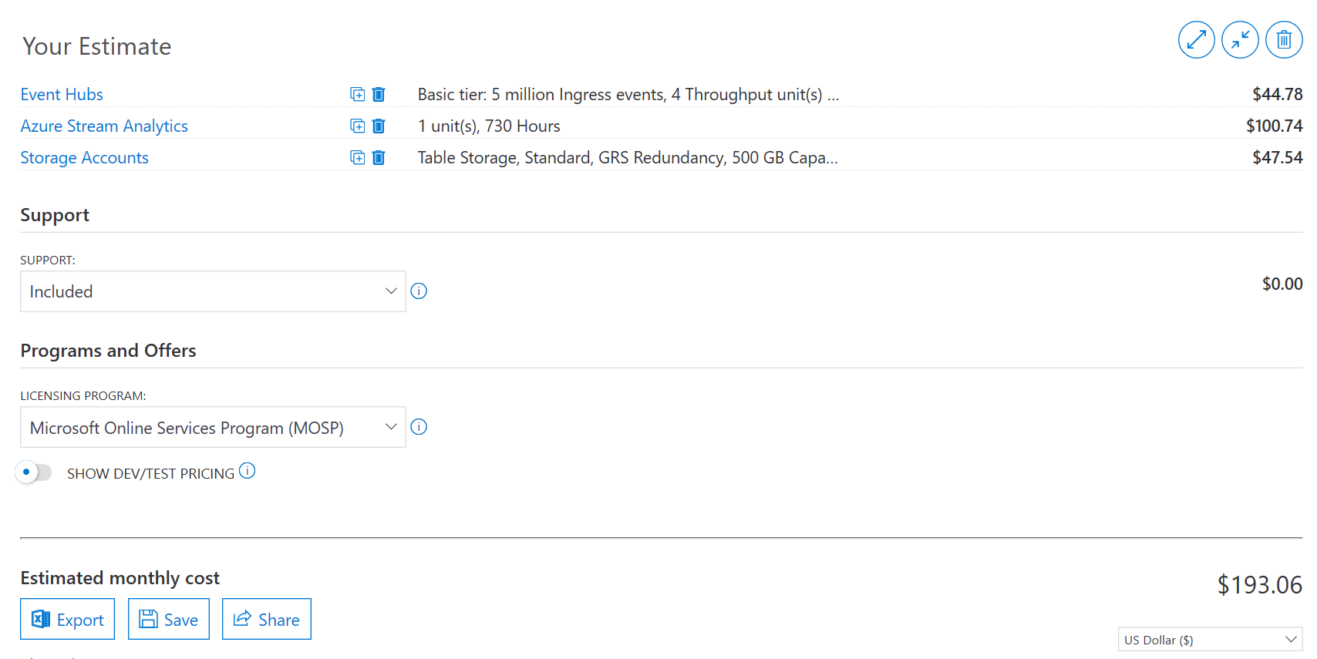
Price
https://azure.microsoft.com/en-us/pricing/calculator/

Slide 13
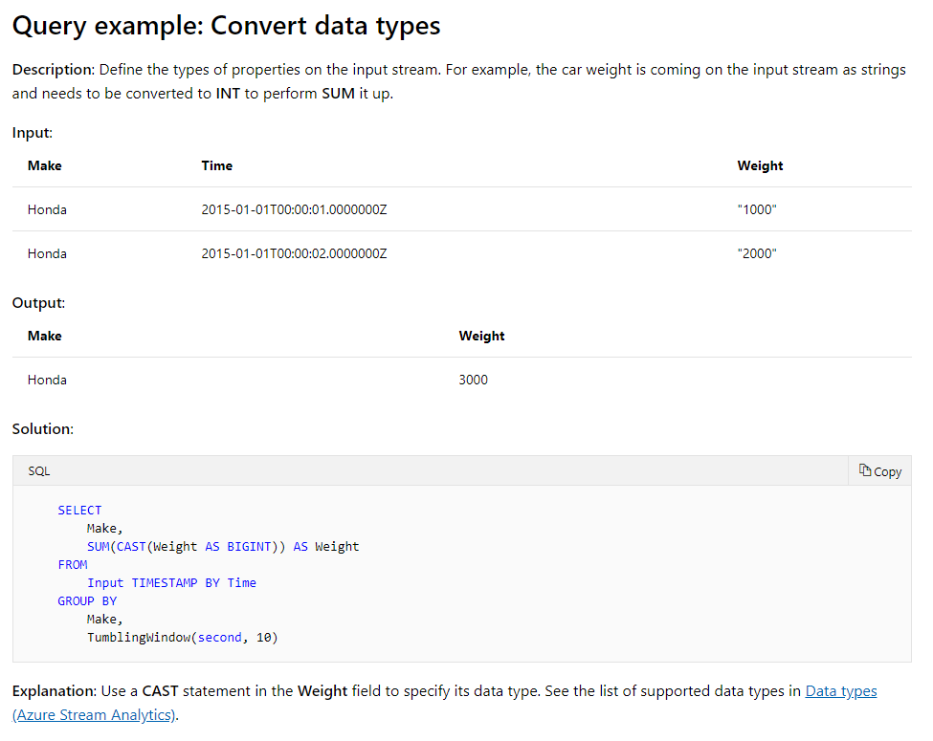
Point: Azure Stream Analytics
In the 1st version, the important point is use of Azure Stream Analytics.
It allows users to define input data processing with SQL like query and connect to many kinds of output destinations, SQL DB, Azure Storage, Azure function, etc.
Query example:
https://docs.microsoft.com/en-us/azure/stream-analytics/stream-analytics-stream-analytics-query-patterns

Slide 14
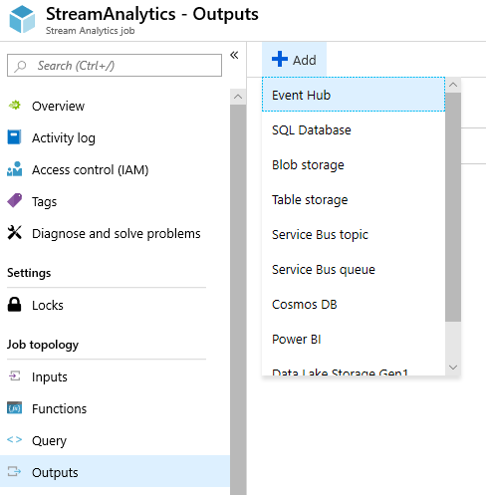
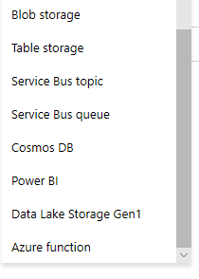
Point: Azure Stream Analytics
Available Output Options:
Only for MS SQL DB, MySQL and PostgreSQL are not supported.

Slide 15
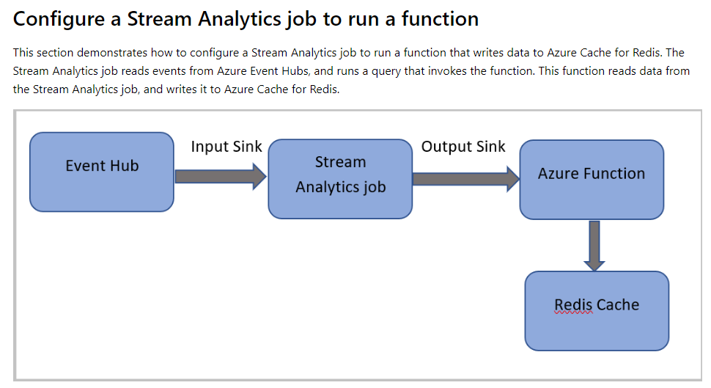
Point: Azure Stream Analytics
Possible pattern with Azure Function:
https://docs.microsoft.com/en-us/azure/stream-analytics/stream-analytics-with-azure-functions

Slide 16
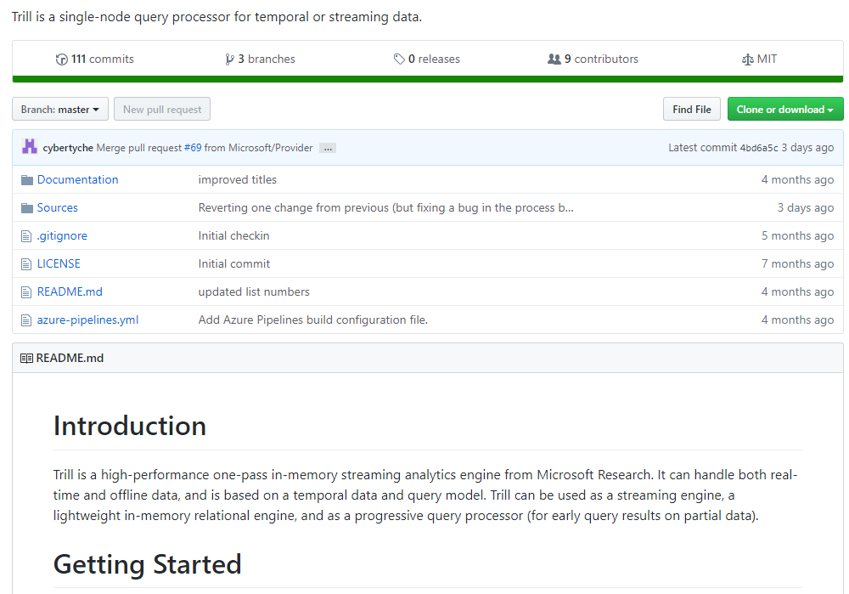
Point: Azure Stream Analytics
The open source streaming engine Trill:
https://github.com/Microsoft/Trill

Slide 17
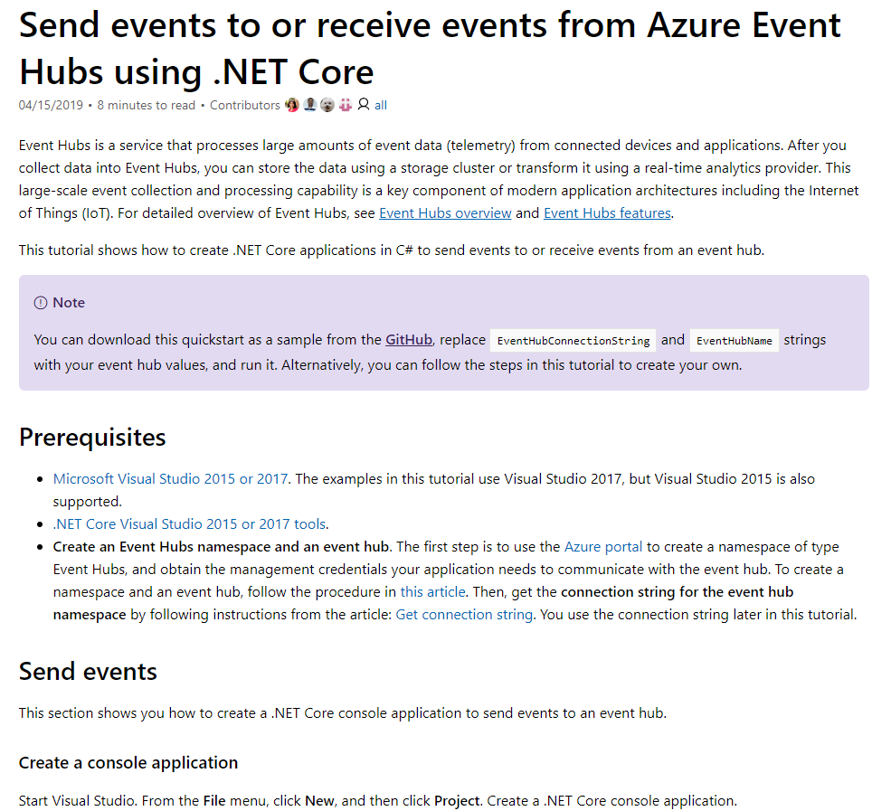
Tutorial Info: Event Hubs
The up-to-date tutorial is in docs.microsoft.com/en-us/azure/. Some of Internet articles might be obsolete.
https://docs.microsoft.com/en-us/azure/event-hubs/event-hubs-dotnet-standard-getstarted-send

Slide 18
Warning Info: Azure Table Storage
I have following mistake experience. With it, the table access performance became terrible…
Wrong usage:
Partition Key | Row Key | Report data1
NoUse | Robot1 | ***
NoUse | Robot2 | $$$
NoUse | … | …
Correct usage:
Partition Key | Row Key | Report data1
Robot1 | NoUse | ***
Robot2 | NoUse | $$$
… | NoUse | …
※If Partition Key value is all same, the table access becomes a sequential access
because the chunk of the target partition key is taken in read access.

Slide 19
Demo

Slide 20
2nd Request
The client started to say they want to control the reporting devices for mostly security reasons. And collected data needs to be manipulated by SQL.
For security, device(robot) registration is needed.
Push notification might be needed also.

Slide 21
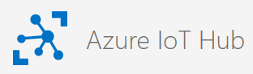
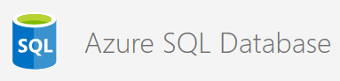
IoT data collecting system 2nd Version
Registration
Push Notification
Lots of reports
Content of reports:
-When to recognize visitor
-Gender of visitor
-Age of visitor
-# of visitor
and so on

Slide 22
IoT data collecting system 2nd Version
IoT Hub can receive and send data
Registration
Push Notification
Lots of reports
:Receiving
:Device Management
Content of reports:
-When to recognize visitor
-Gender of visitor
-Age of visitor
-# of visitor
and so on
:Filtering
:Storing

Slide 23
IoT data collecting system 2nd Version
Registration
Push Notification
Same as 1st version
Lots of reports
:Receiving
:Device Management
Content of reports:
-When to recognize visitor
-Gender of visitor
-Age of visitor
-# of visitor
and so on
:Filtering
:Storing

Slide 24
IoT data collecting system 2nd Version
Registration
Push Notification
Lots of reports
:Receiving
:Device Management
Storing into SQL DB for more flexible data manipulation
Content of reports:
-When to recognize visitor
-Gender of visitor
-Age of visitor
-# of visitor
and so on
:Filtering
:Storing

Slide 25
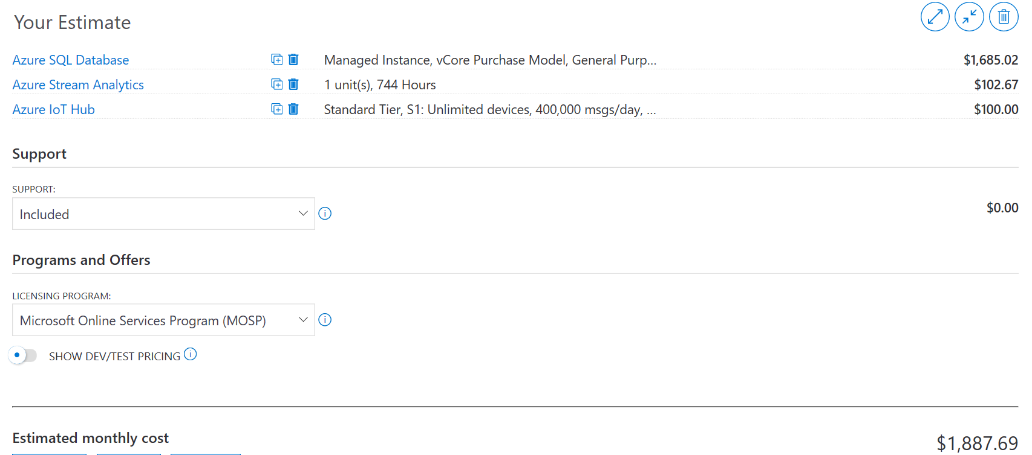
Price
https://azure.microsoft.com/en-us/pricing/calculator/

Slide 26
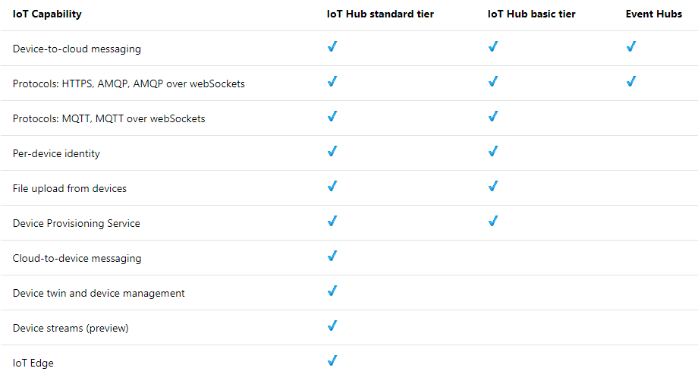
Point: Azure IoT Hub
In the 2nd version, the important point is use of IoT Hub.
With it, connected devices can be visible.
Comparison between IoT Hub and Event Hubs:
https://docs.microsoft.com/en-us/azure/iot-hub/iot-hub-compare-event-hubs

Slide 27
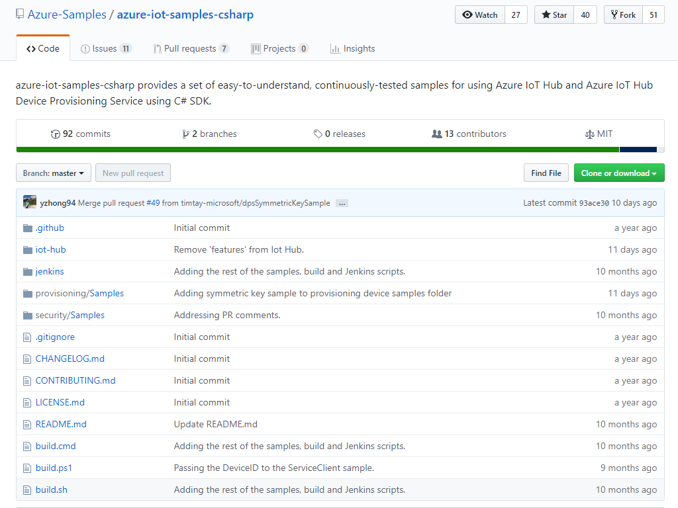
Point: Azure IoT Hub
Sample codes are in GitHub.
https://github.com/Azure-Samples/azure-iot-samples-csharp

Slide 28
Demo

Slide 29
But we couldn’t use most of Auzre IoT Hub functions due to the device side limitation. And we, developers, got bye-bye…

Slide 30
Azure sphere

Slide 31
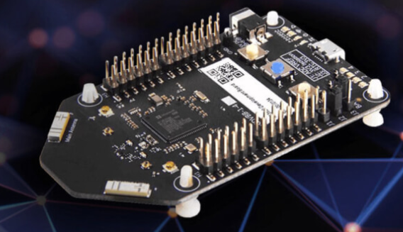
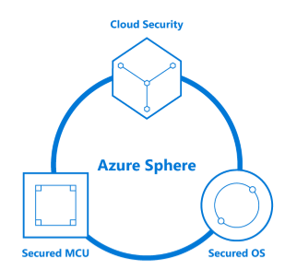
Very Secure IoT Device from MS: Azure Sphere
Recently, Microsoft released secure IoT device, Azure Sphere. It’s very secure according to Microsoft. Thus, in the case we faced, maybe it matches and deserves to be tried.
https://azure.microsoft.com/en-us/services/azure-sphere/

Slide 32
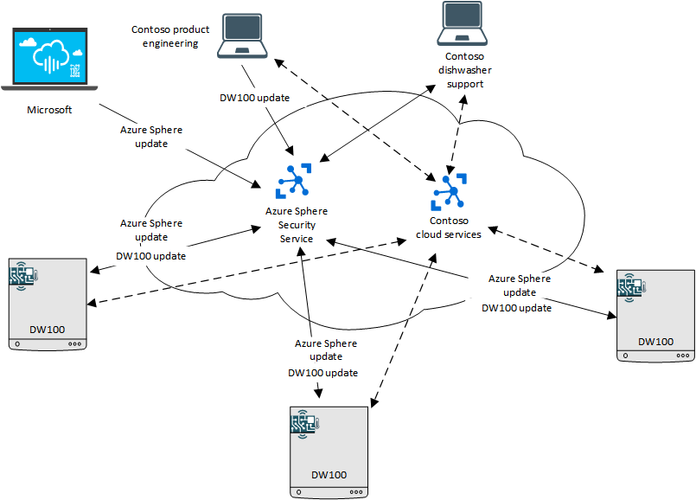
Azure Sphere scenario
Azure Sphere is expected to embedded into home devices in future.
https://docs.microsoft.com/en-us/azure-sphere/product-overview/scenario

Slide 33
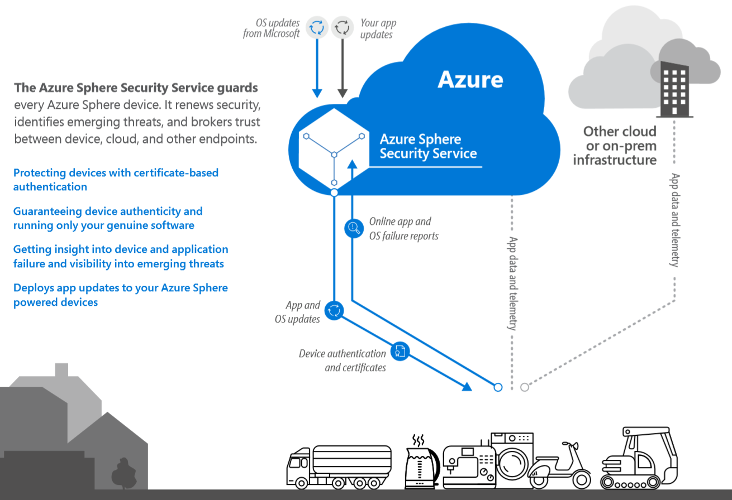
Azure Sphere with Azure
Azure Sphere will be very secure with Azure service.
https://www.microsoft.com/en-us/azure-sphere/wp-content/uploads/sites/7/2018/04/AzureSphere_OpenCloud.pdf

Slide 34
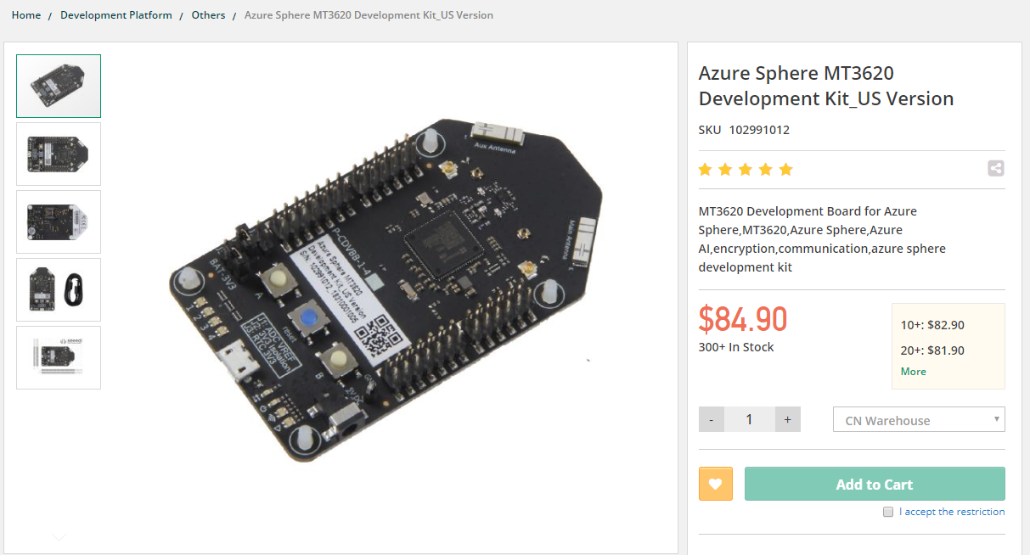
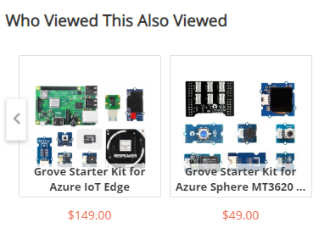
How to get Azure Sphere
It can be ordered from Web but not sure if it can be delivered to Manila…
https://www.seeedstudio.com/Azure-Sphere-MT3620-Development-Kit-US-Version.html

Slide 35
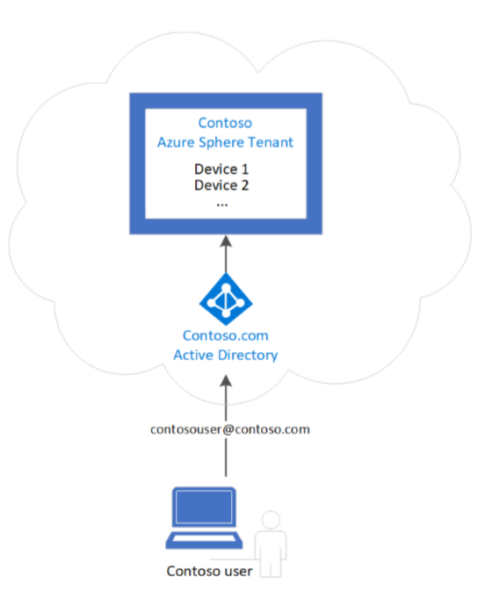
How to use Azure Sphere
To use Azure Sphere, following preparations are needed.
Visual Studio 2017 & Azure Sphere SDK for Visual Studio
Creating Azure Sphere tenant in Azure, which needs original domain.
Relating Azure Sphere device to Azure service
Deploying a program into Azure Sphere device
Application is written in C language and supports single task only in current preview version.
Guaranteeing security makes lots of limitations…
Original domain is needed.

Slide 36
Demo

Slide 37
END

Slide 38
Extra

Slide 39

About Wankuma
Wan-わん- is “bowwow” by dog in Japanese.
Kuma-くま- is “bear” in Japanese.
The 2 founder of Wankuma Alliance named it with almost joking, but the activity became quite long

Slide 40
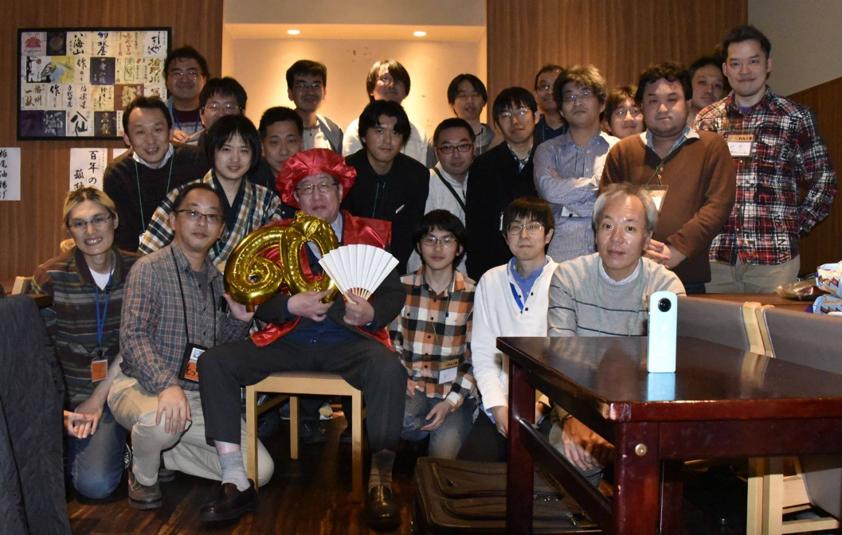
Wankuma Alliance @Tokyo

Slide 41
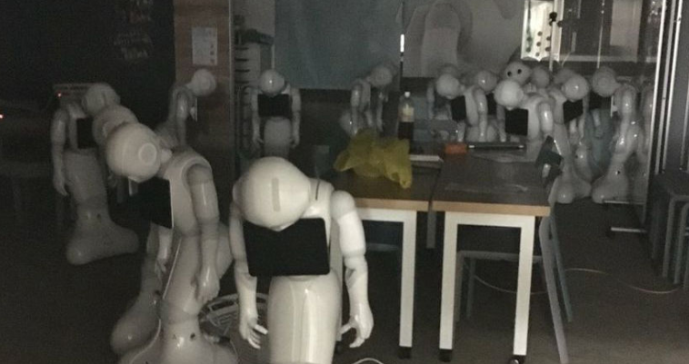
It seems not so successful as business…
There was news that most companies didn’t extend their robot lease contracts…
Even with advanced technologies, companies still need challenges

Slide 42
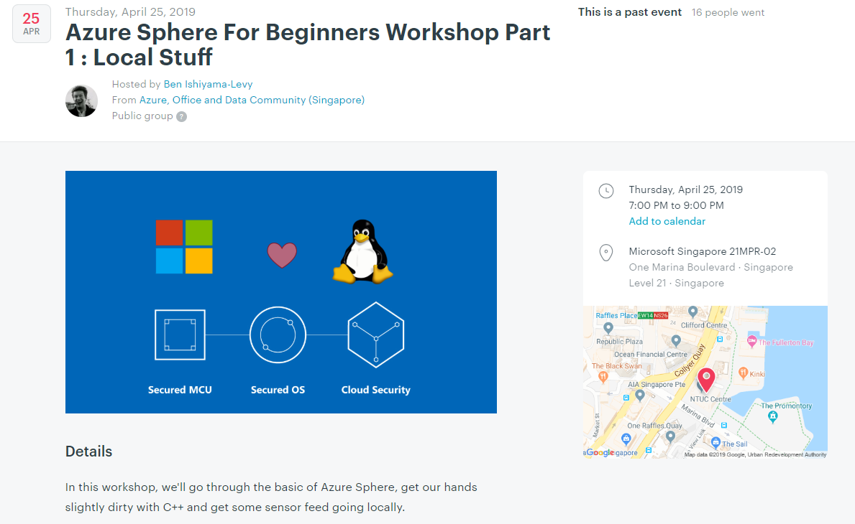
Azure Sphere event in Singapore

